Slide 1
BAPUJI INSTITUTE OF ENGINEERING AND TECHNOLOGY
TOPIC:FLAPPY-BIRD GAME CLONE
MOHAMMED JAHANGEER 4BD20CS057 HARSHAVARDHAN S SHET 4BD20CS035

Slide 2

INTRODUCTION
Pygame is a cross-platform set of Python modules designed for writing video games. It includes computer graphics and sound libraries designed to be used with the Python programming language.
Pygame was originally written by Pete Shinners. It has been a community project since 2000 and is released under the free software GNU Lesser General Public License (which "provides for Pygame to be distributed with open source and commercial software").
Flappy Bird is a mobile game developed by the Vietnamese video game artist and programmer Dong Nguyen. The game is a side-scroller where the player controls a bird, attempting to fly between columns of green pipes without hitting them.

Slide 3
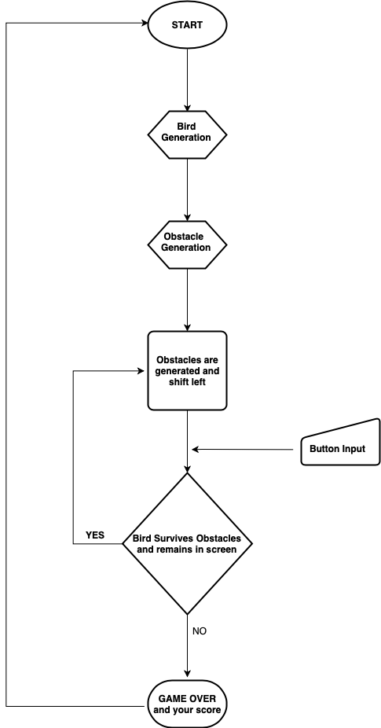
FLOWCHART
THE WINDOW IS CREATED, BACKGROUND IMAGE IS APPLIED AND BIRD OBJECT IS CREATED.
ONCE THE GAME STARTS, PIPES ARE GNERATED AFTER A CONSTANT INTERVAL AND THEY ARE SHIFTED TO THE LEFT WHICH GIVES THE ILLUSION THAT THE BIRD IS MOVING RIGHT.
IF THE BIRD TOUCHES THE PIPE IT IS GAME OVER, ELSE GAME CONTINUES.

Slide 4
PSEUDO CODE
CREATE WINDOW, APPLY BACKGROUND, SHOW START SCREEN
WAIT FOR USER INPUT (SPACE BAR) TO START GAME
IF USER PRESSES SPACE, GAME STARTS
WHILE IN GAME
IF BIRD’S X-Y POSITION COINCIDES WITH PIPE’S X-Y POSITION
THEN GAME OVER DISPLAY SCORE AND MAX SCORE
IF PRESENT SCORE IS GREATER THAN MAX SCORE
DISPLAY NEW HIGH SCORE
ELSE KEEP RUNNING GAME AND COUNT SCORE

Slide 5
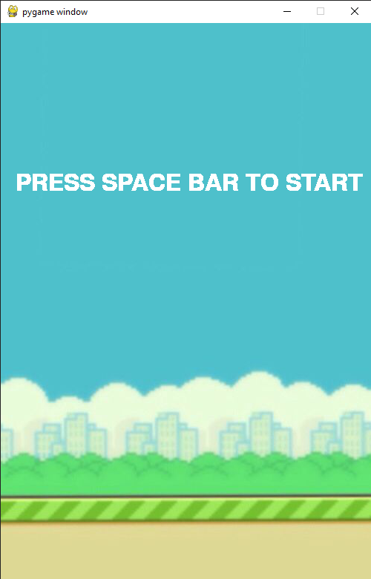
SNAPSHOTS
START SCREEN

Slide 6
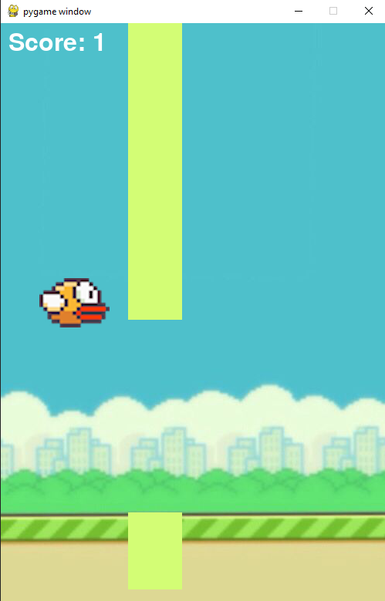
SNAPSHOTS
MID GAME

Slide 7
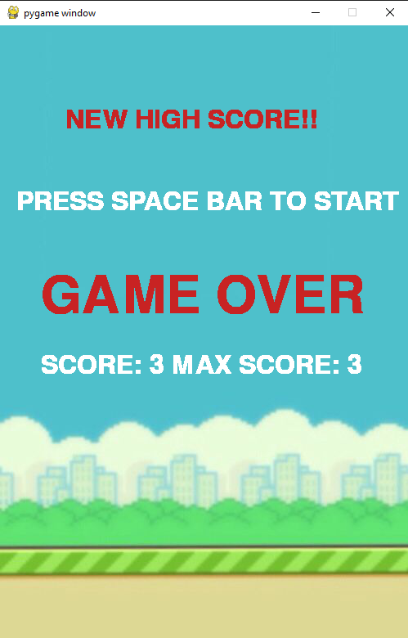
SNAPSHOTS
GAME OVER

Slide 8
CONCLUSION
Implement event loops
Draw items on the screen
Play sound effects and music
Handle user input
To do this, you used a subset of the pygame modules, including the display, mixer and music, time, image, event, and key modules. You also used several pygame classes, including Rect, Surface, Sound, and Sprite. But these only scratch the surface of what pygame can do.

